Slide 1
Fit de forme des miroirs en sortie de chez Boostec
A. Pavageau 04/25

Slide 2
Export Control Information
Section 1 (not applicable in France, please go to section 3)
This document contains Technical Information : Yes ☒ No ◻
If No to section1: please complete Section 2
If Yes to section1: please complete Section 3 as applicable
Section 2 (not applicable in France, please go to section 3)
I confirm the document does not contain Technical Information and is « Not-Technical »
Name:
Date:
Section 3
3a. National and EU regulations Export Control Assessment
This document has been assessed against applicable export control regulations in
☒ France ◻ Germany ◻ Spain ◻ UK ◻ Other: [Specify the country]
◻ and does not contains Controlled Technology¹ and is therefore « Not Listed / Not Controlled »
☒ and contains Controlled Technology with export control classification EU FR 6E002 (hardware 6A004.c.1)
Note: Any transfer of this document in part or in whole must be made in accordance with the appropriate export control regulations. Prior to any transfer outside of the responsible legal entity, confirmation of an applicable export licence or authorisation must be obtained from the local Export Control Officer (ECO).
3b. US (ITAR/EAR) Export Control Assessment
◻ This document does not contains US origin Technical Data (Technology)
◻ This document contains « Technology » which is controlled by the U.S government under [USML category number / ECCN] and which has been received by [Legal entity] under the authority of [Licence number / ITAR exemption / EAR licence exception / NLR]
◻ This document contains technology which is designated as EAR99 (subject to EAR and not listed on the USML/CCL.)
Note: Any re-export or re-transfer of this document in part or in whole must be made in accordance with the appropriate regulation (ITAR or EAR) and applicable authorization. If in any doubt please contact your local ECO.
3c. Technical Rater Information
This document has been assessed by the following Technical Rater :
Assessed and classified by: A. Pavageau
Date classification completed: 11/04/25
¹ “Controlled Technology” is defined as any Information necessary for the design, development, production, use, operation, maintenance or repair of export controlled goods. Examples of such Information are blueprints, plans, diagrams, models, engineering designs, manuals, requirements specifications and instructions etc. If in any doubt please contact your local Export Control Officer (ECO)

Slide 3
Remarques générales
Le flou/litige concernant « la méthode de fit »/nombre de degrés de libertés lors du fit qui existait entre Boostec est REOSC est très probablement un faux problème: le vrai problème est le fait que la taille de la zone palpée n’est pas la même entre Boostec, REOSC, chose qu’il faut corriger à l’avenir (imposer une taille commune aux 2; se baser sur la taille de REOSC).
Planches suivantes je calcul le fit de forme par bougé rigide et moindres carrés
RMS after 6-dof fit : 4.7 µm RMS
PTV after 6-dof fit : 20.8 µm
6-dof fit: (µm & µrad)\n
TX | TY | TZ | RX | RY | RZ |
-0.4 | -0.7 | -0.8 | 144.3 | -78.0 | 0.2 |
| | 1 | 81 | 39 | |%
La ligne jaune c’est les bougés qui donnent le résidu minimum, les bougés après lesquels ils répondent à notre tolérance sur la forme de la face opt. La valeur PtV verte c’est justement la forme atteinte.
La ligne rose c’est une info en plus: c’est une indication de si le bougé sur chaque ddl est utile/efficace ou non. La ligne rose donne la variation de RMS si on désactive le ddl. Dans l’exemple: si on désactive le bougé Rx on perd 80% de la RMS.

Slide 4
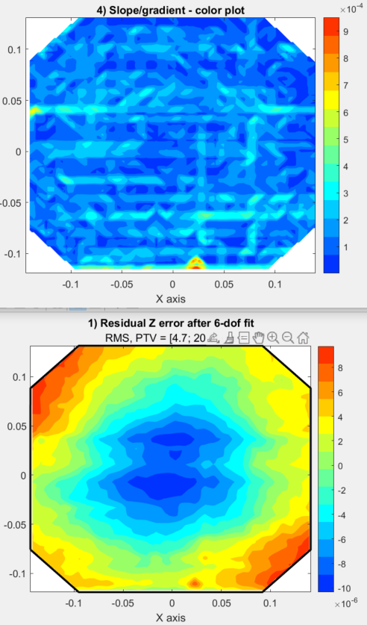
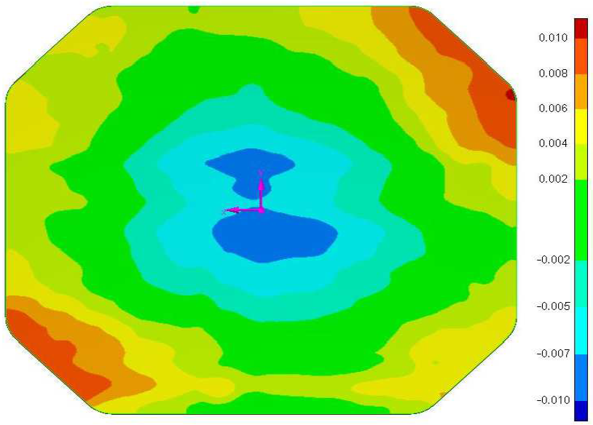
LSTM - M1_CB2_13216_15840_final
\\silvershare.fr.astrium.corp\PART\L\LSTM_B2CD_INDUS\Com\02 - Procurement\04 - SiC (BOOSTEC)\01-Meetings\06- DRB\DRB FM2 SCAN M1 M2V M3V\M1\Not for ESA and prime\M1_CB2_13216_15840_final.txt
840 points read
[X,Y] size = [0.285, 0.251]
RMS before fit: 193.5 µm RMS
TZ-fit: 193.0453 µm
RMS after TZ fit: 12.9 µm RMS
RMS after 6-dof fit : 4.7 µm RMS
PTV after 6-dof fit : 20.8 µm
6-dof fit: (µm & µrad)\n
TX | TY | TZ | RX | RY | RZ |
-0.4 | -0.7 | -0.8 | 144.3 | -78.0 | 0.2 |
| | 1 | 81 | 39 | |%
Volume under surface = 6.69e-01 mm²
PV Boostec

Slide 5
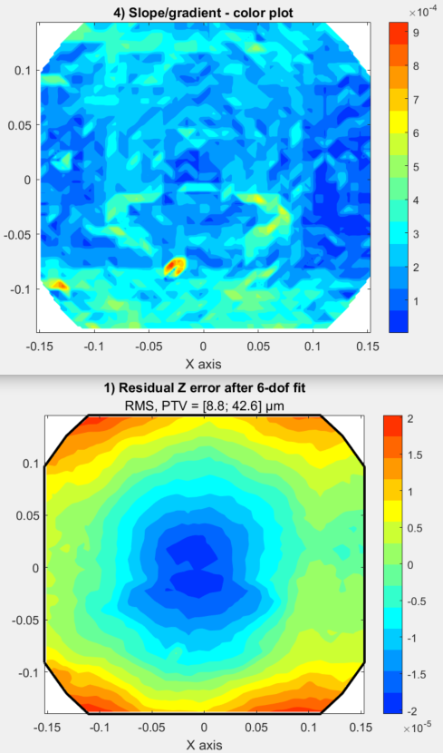
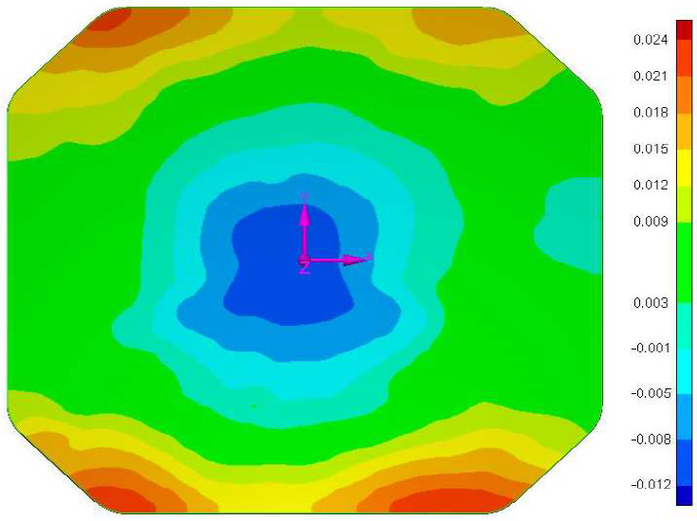
LSTM - M3VIS_CB2_13390_15841_final
\\silvershare.fr.astrium.corp\PART\L\LSTM_B2CD_INDUS\Com\02 - Procurement\04 - SiC (BOOSTEC)\01-Meetings\06- DRB\DRB FM2 SCAN M1 M2V M3V\M3V\Not for ESA and Prime\M3VIS_CB2_13390_15841_final.txt
852 points read
[X,Y] size = [0.307, 0.286]
RMS before fit: 227.7 µm RMS
TZ-fit: -227.2549 µm
RMS after TZ fit: 14.2 µm RMS
RMS after 6-dof fit : 8.8 µm RMS
PTV after 6-dof fit : 42.6 µm
6-dof fit: (µm & µrad)\n
TX | TY | TZ | RX | RY | RZ |
1.6 | -0.4 | 0.1 | -29.7 | -123.2 | -0.3 |
| | | 6 | 96 | |%
Volume under surface = 1.64e+00 mm²
PV Boostec

Slide 6
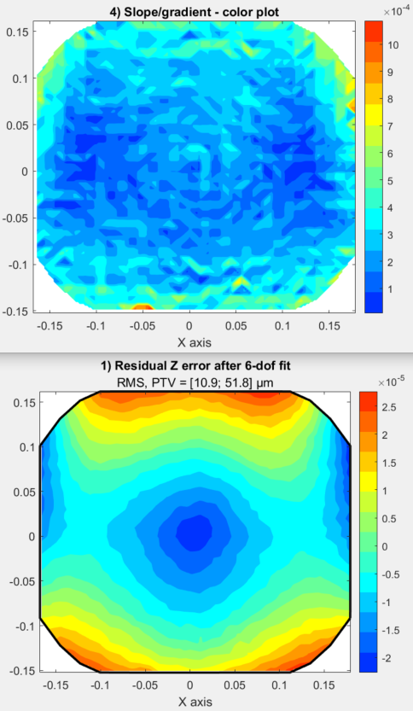
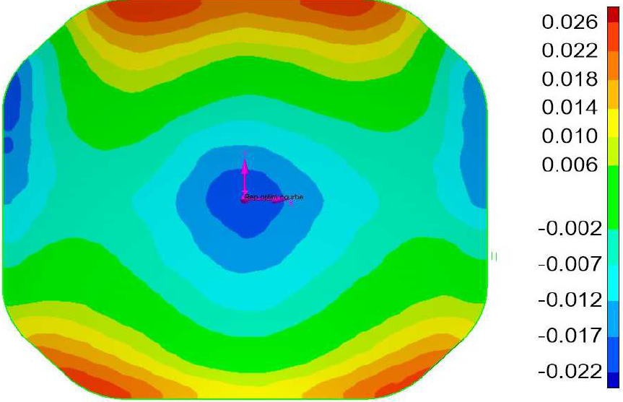
LSTM - M3TIR_CB2_14114_14771_final
\\silvershare.fr.astrium.corp\PART\L\LSTM_B2CD_INDUS\Com\02 - Procurement\04 - SiC (BOOSTEC)\01-Meetings\06- DRB\DRB PFM M2T M3T\M3T SNxxxxx\DRB\M3TIR_CB2_14114_14771_final.txt
952 points read
[X,Y] size = [0.347, 0.314]
RMS before fit: 12.3 µm RMS
TZ-fit: -1.0564 µm
RMS after TZ fit: 12.3 µm RMS
RMS after 6-dof fit : 10.9 µm RMS
PTV after 6-dof fit : 51.8 µm
6-dof fit: (µm & µrad)\n
TX | TY | TZ | RX | RY | RZ |
-0.5 | -0.8 | -0.4 | 50.8 | -34.1 | -0.2 |
| | 1 | 66 | 37 | |%
Volume under surface = 2.28e+00 mm²
PV Boostec

Slide 7
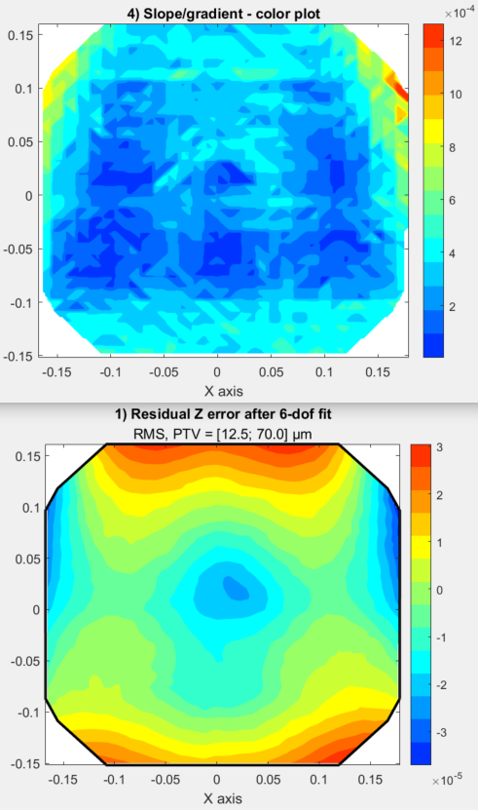
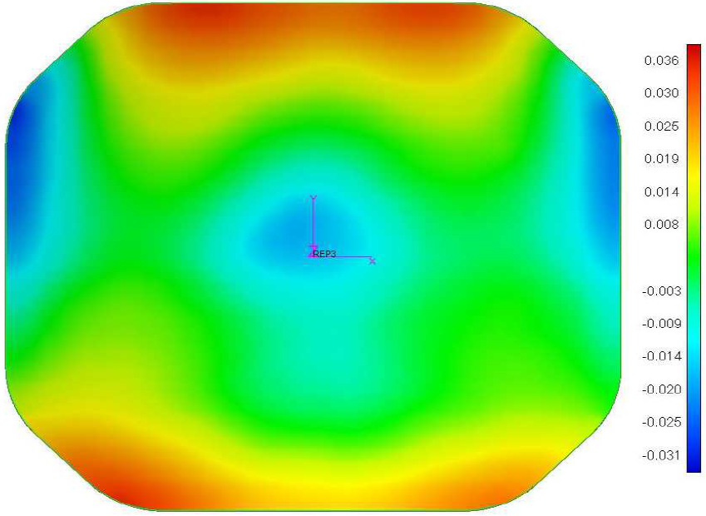
LSTM spare - M3TIR_CB2_15132_final
\\silvershare.fr.astrium.corp\PART\L\LSTM_B2CD_INDUS\Com\02 - Procurement\04 - SiC (BOOSTEC)\01-Meetings\06- DRB\DRB Spare mirrors\Doc miroirs spare\M3T SN15132\Doc interne ADS ne pas diffuser\M3TIR_CB2_15132_final.txt
836 points read
[X,Y] size = [0.346, 0.313]
RMS before fit: 97.6 µm RMS
TZ-fit: 91.6194 µm
RMS after TZ fit: 33.6 µm RMS
RMS after 6-dof fit : 12.5 µm RMS
PTV after 6-dof fit : 70.0 µm
6-dof fit: (µm & µrad)\n
TX | TY | TZ | RX | RY | RZ |
-4.7 | 1.5 | -1.2 | -97.4 | -303.0 | 1.7 |
| | | 13 | 95 | |%
Volume under surface = 3.71e+00 mm²
PV Boostec

Slide 8
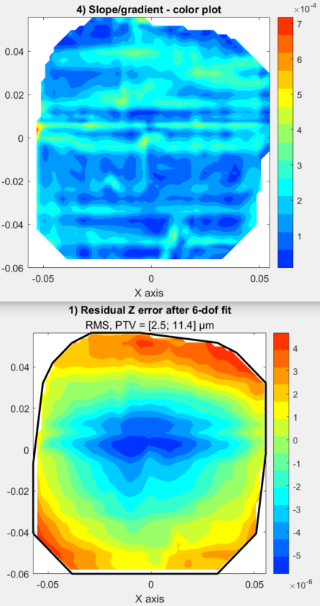
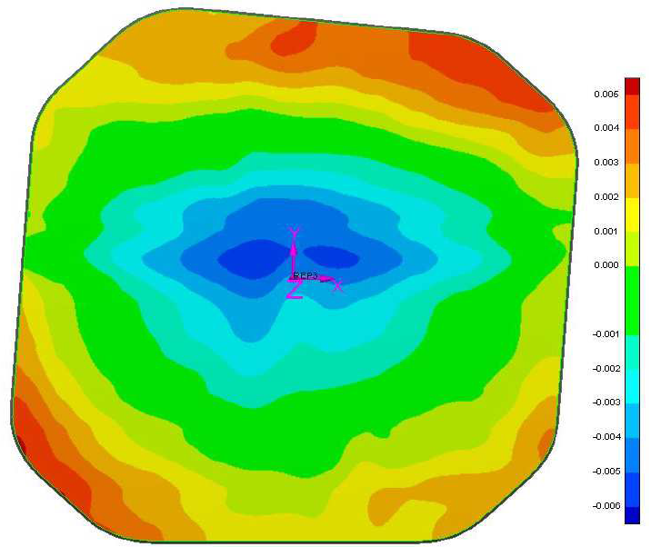
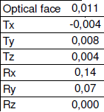
LSTM - M2TIR_14113_14663_CB2_final_v2_FEMAP
\\silvershare.fr.astrium.corp\part\L\LSTM_B2CD_INDUS\Com\02 - Procurement\04 - SiC (BOOSTEC)\01-Meetings\06- DRB\Fichiers .txt miroirs
544 points read
[X,Y] size = [0.113, 0.117]
RMS before fit: 7.0 µm RMS
TZ-fit: -4.2448 µm
RMS after TZ fit: 5.5 µm RMS
RMS after 6-dof fit : 2.5 µm RMS
PTV after 6-dof fit : 11.4 µm
6-dof fit: (µm & µrad)\n
TX | TY | TZ | RX | RY | RZ |
-0.1 | 0.2 | -0.4 | -140.1 | -66.6 | -0.1 |
| | 1 | 90 | 25 | |%
Volume under surface = 6.58e-02 mm²
PV Boostec:

Slide 9
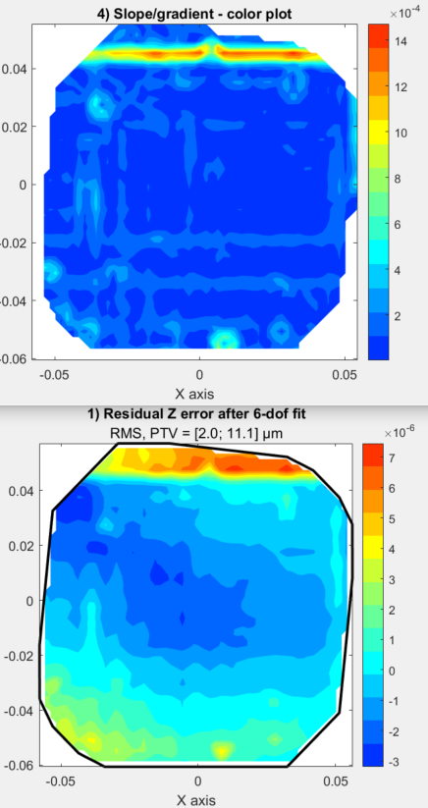
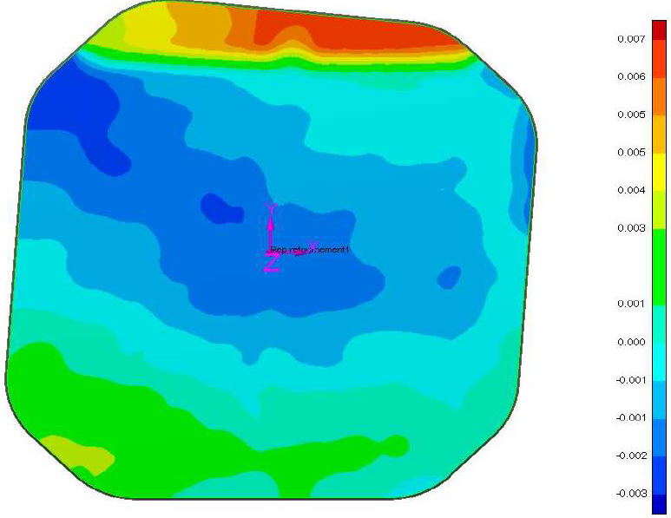
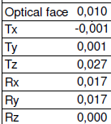
LSTM - M2TIR_CB2_14111_15057_final_v2
\\silvershare.fr.astrium.corp\part\L\LSTM_B2CD_INDUS\Com\02 - Procurement\04 - SiC (BOOSTEC)\01-Meetings\06- DRB\Fichiers .txt miroirs
\\silvershare.fr.astrium.corp\part\L\LSTM_B2CD_INDUS\Com\02 - Procurement\04 - SiC (BOOSTEC)\05-Inspections - Prooftest\Mirrors\M2T\14111 - FM2
533 points read
[X,Y] size = [0.114, 0.118]
RMS before fit: 27.0 µm RMS
TZ-fit: -26.8984 µm
RMS after TZ fit: 2.2 µm RMS
RMS after 6-dof fit : 2.0 µm RMS
PTV after 6-dof fit : 11.1 µm
6-dof fit: (µm & µrad)\n
TX | TY | TZ | RX | RY | RZ |
-0.0 | 0.0 | -0.1 | -22.9 | -10.9 | -0.0 |
| | 1 | 87 | 18 | |%
Volume under surface = 9.07e-02 mm²
Marche NOK > 1mrad
PV Boostec:

Slide 10
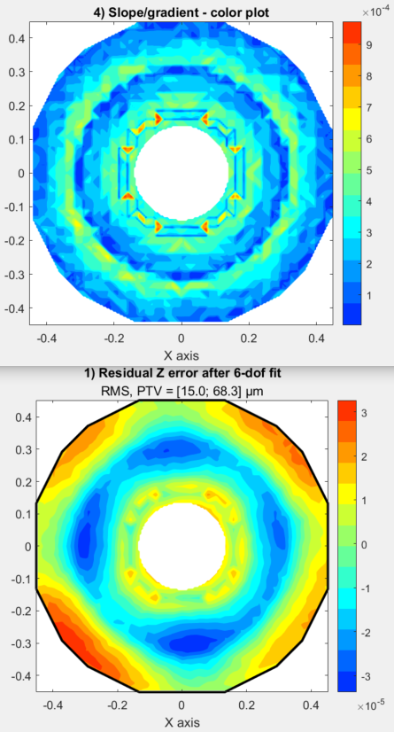
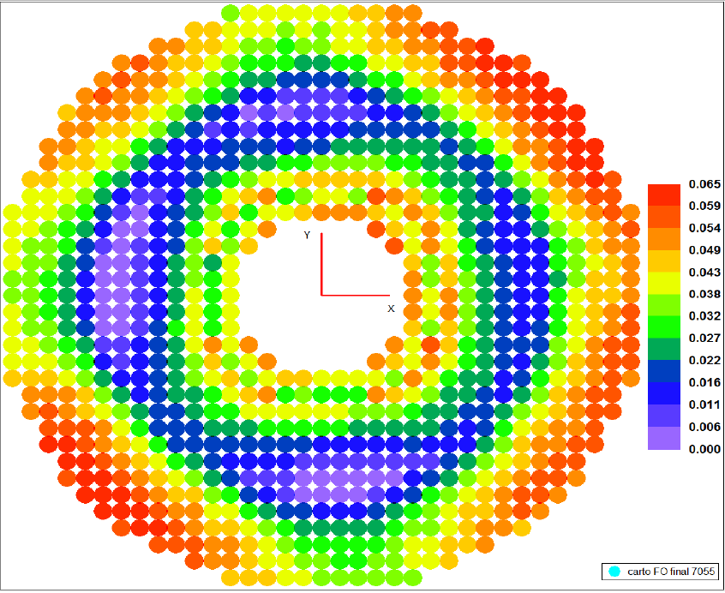
NAOMIX M1 - FM4 SN 7055 02
\\silvershare.fr.astrium.corp\PART\V\v2020\Com\D_Instrument NAOMIX\D-02_Ingenierie\D-02-b_Mécanique\2.1.Boostec\DRB_FM1-FM4\miroir M1\SN 7055\DRB\A7 - coord XYZ eppeau epCVD -M1 FM4 SN 7055 02.xlsx
NB: les points donnés ont l’air d’être des centres billes, j’ai adapté mon code. Mais leur PV a l’air de raisonner sur les centres billes
928 points read
[X,Y] size = [0.902, 0.902]
RMS before fit: 45.5 µm RMS
TZ-fit: -42.1146 µm
RMS after TZ fit: 17.3 µm RMS
RMS after 6-dof fit : 15.0 µm RMS
PTV after 6-dof fit : 68.3 µm
6-dof fit: (µm & µrad)\n
TX | TY | TZ | RX | RY | RZ |
0.8 | -0.2 | -0.0 | -6.4 | -34.3 | -0.0 |
| | | 4 | 97 | |%
Volume under surface = 2.03e+01 mm²
PV Boostec:
Tol forme: 65µm

Slide 11
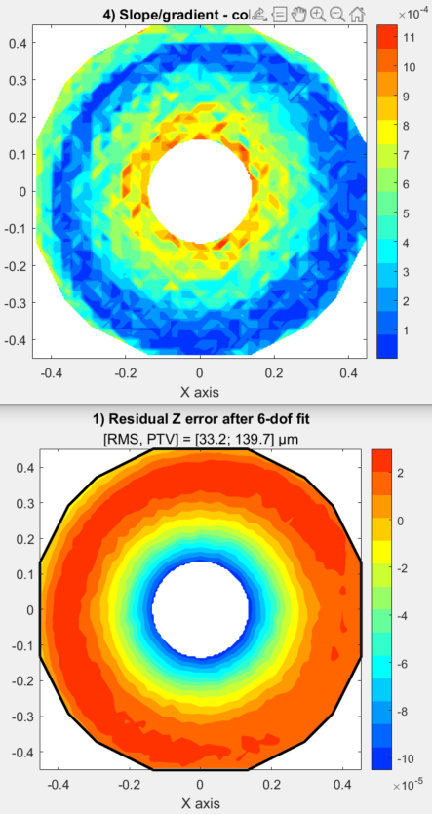
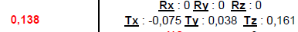
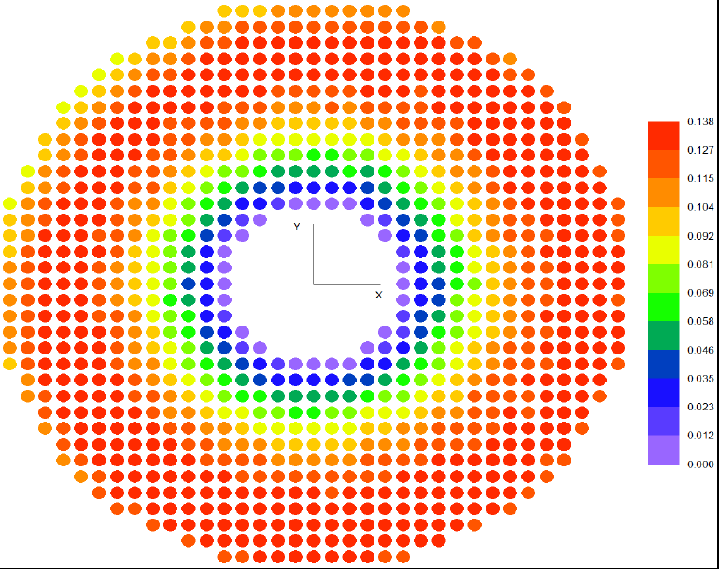
NAOMIX M1 -
\\silvershare.fr.astrium.corp\PART\V\v2020\Com\D_Instrument NAOMIX\D-02_Ingenierie\D-02-b_Mécanique\2.1.Boostec\DRB_FM1-FM4\miroir M1\SN 9186\DRB\Naomix_M1_9186_10834_ctl final 05.2.20.xls
928 points read
[X,Y] size = [0.902, 0.902]
RMS before fit: 134.1 µm RMS
TZ-fit: -129.8017 µm
RMS after TZ fit: 33.8 µm RMS
RMS after 6-dof fit : 33.2 µm RMS
PTV after 6-dof fit : 139.7 µm
6-dof fit: (µm & µrad)\n
TX | TY | TZ | RX | RY | RZ |
0.6 | -0.2 | -0.0 | -8.3 | -23.5 | 0.0 |
| | | 11 | 89 | |%
Volume under surface = 6.52e+01 mm²
PV Boostec:
Tol forme

Slide 12
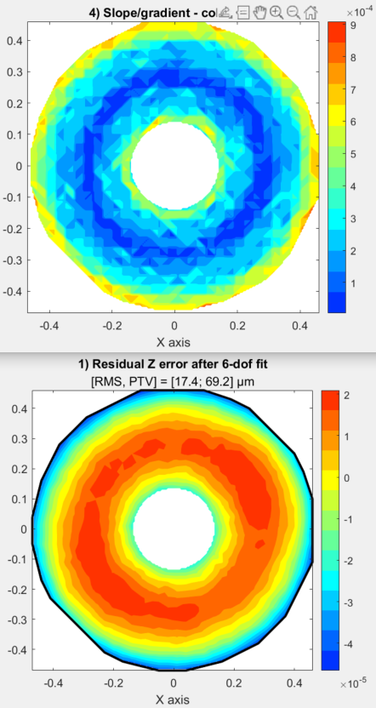
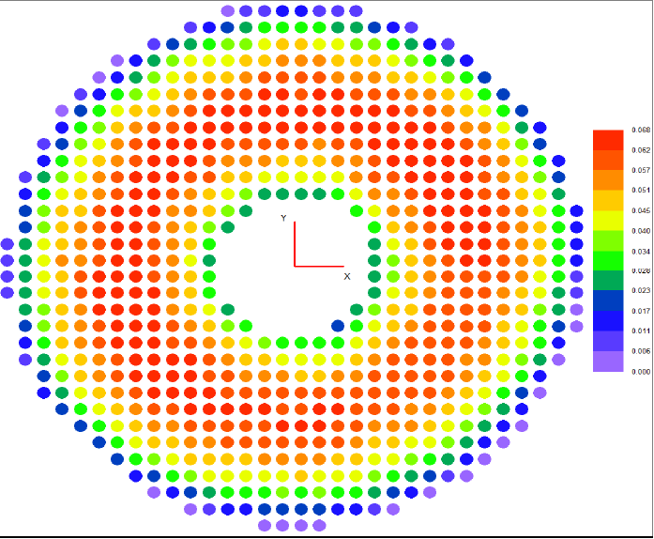
NAOMIX M1 - XYZ ep CVD -M1 SN 6076
\\silvershare.fr.astrium.corp\PART\V\v2020\Com\D_Instrument NAOMIX\D-02_Ingenierie\D-02-b_Mécanique\2.1.Boostec\DRB_FM1-FM4\miroir M1\M1 FM1\DRB\A7 - XYZ ep CVD -M1 SN 6076.xlsx
734 points read
[X,Y] size = [0.930, 0.930]
RMS before fit: 93.1 µm RMS
TZ-fit: -91.3129 µm
RMS after TZ fit: 18.1 µm RMS
RMS after 6-dof fit : 17.4 µm RMS
PTV after 6-dof fit : 69.2 µm
6-dof fit: (µm & µrad)\n
TX | TY | TZ | RX | RY | RZ |
-0.2 | 0.5 | -0.0 | 18.6 | 8.0 | 0.0 |
| | | 85 | 16 | |%
Volume under surface = 3.02e+01 mm²
PV Boostec:
Tol forme: 68µm

Slide 13
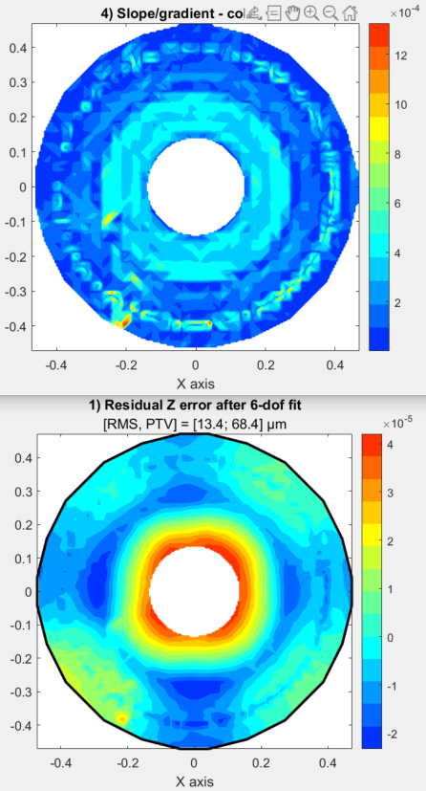
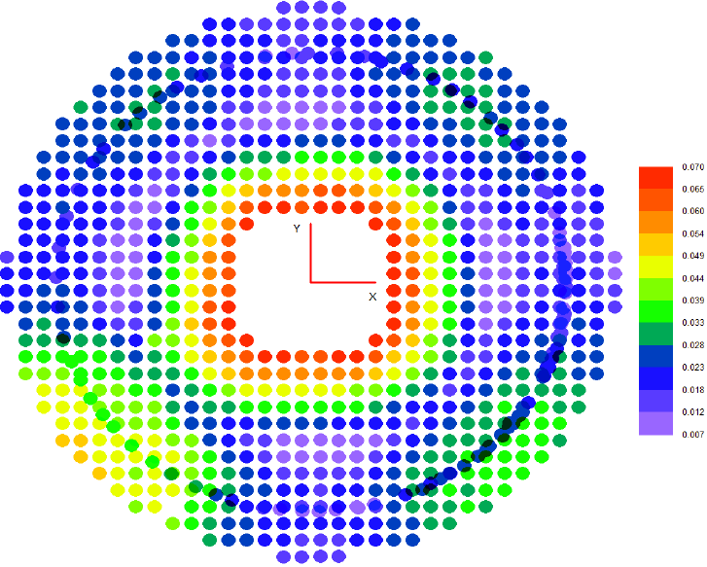
NAOMIX M1 - coord XYZ-ep CVD & point complémentaire M1 SN 6077
\\silvershare.fr.astrium.corp\PART\V\v2020\Com\D_Instrument NAOMIX\D-02_Ingenierie\D-02-b_Mécanique\2.1.Boostec\DRB_FM1-FM4\miroir M1\M1 FM2\drb\A7 - coord XYZ-ep CVD & point complementaire M1 SN 6077.xlsx
909 points read
[X,Y] size = [0.942, 0.942]
RMS before fit: 32.6 µm RMS
TZ-fit: -28.3254 µm
RMS after TZ fit: 16.0 µm RMS
RMS after 6-dof fit : 13.4 µm RMS
PTV after 6-dof fit : 68.4 µm
6-dof fit: (µm & µrad)\n
TX | TY | TZ | RX | RY | RZ |
0.8 | 0.3 | -0.4 | 12.7 | -33.0 | 0.0 |
| | | 14 | 90 | |%
Volume under surface = 1.50e+01 mm²
PV Boostec:
Tol forme: 63µm

Slide 14
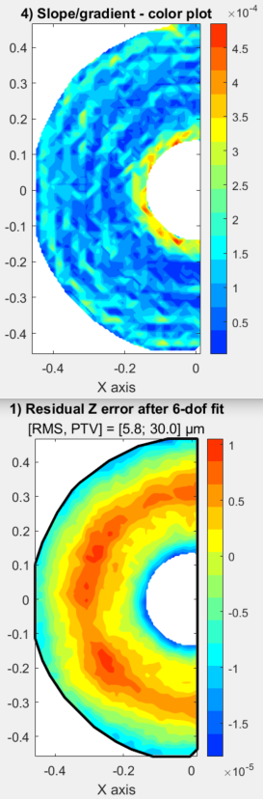
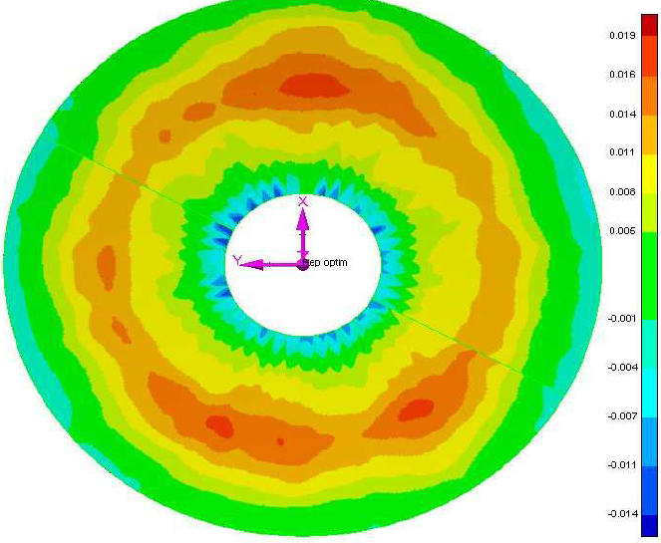
NAOMIX M1 - sn_7953
\\silvershare.fr.astrium.corp\PART\V\v2020\Com\D_Instrument NAOMIX\D-02_Ingenierie\D-02-b_Mécanique\2.1.Boostec\DRB_FM5-FM8\M1\sn_7953\06_DRB_apres_CVD_3eme_run\Naomix_M1_7953_12379_final_24.2.22.xls
=> ne contient qu’un demi miroir…
\\silvershare.fr.astrium.corp\PART\V\v2020\Com\D_Instrument NAOMIX\D-02_Ingenierie\D-02-b_Mécanique\2.1.Boostec\DRB_FM5-FM8\M1\sn_7953\06_DRB_apres_CVD_3eme_run\M1_7953_12379_CB2_final.txt
=> pénible de reconstruire la métrologie…
744 points read
[X,Y] size = [0.474, 0.926]
RMS before fit: 365.6 µm RMS
TZ-fit: -365.5701 µm
RMS after TZ fit: 6.4 µm RMS
RMS after 6-dof fit : 5.8 µm RMS
PTV after 6-dof fit : 30.0 µm
6-dof fit: (µm & µrad)\n
TX | TY | TZ | RX | RY | RZ |
-0.3 | 0.2 | -2.8 | 8.8 | 13.7 | -0.1 |
| | 96 | 62 | 133 | |%
Volume under surface = 5.93e+00 mm²

Slide 15
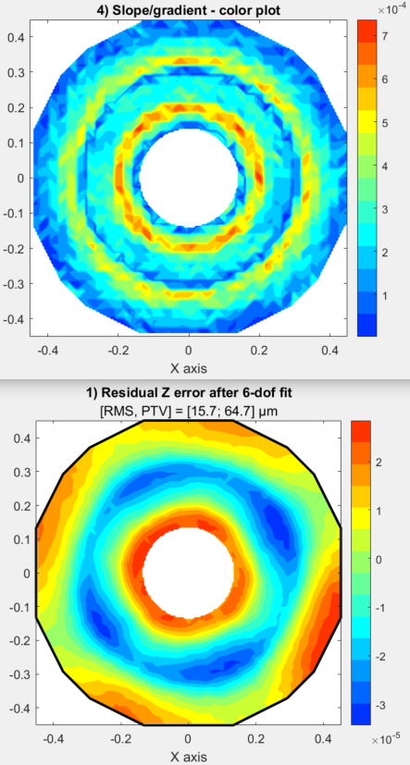
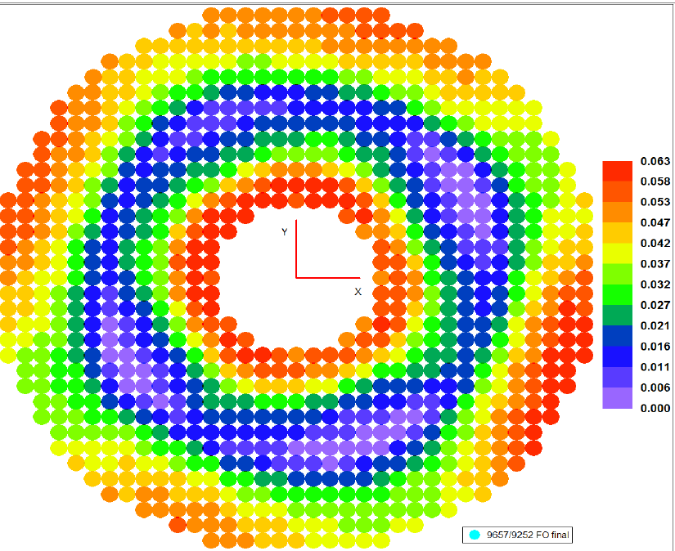
NAOMIX M1 - sn_9252
\\silvershare.fr.astrium.corp\PART\V\v2020\Com\D_Instrument NAOMIX\D-02_Ingenierie\D-02-b_Mécanique\2.1.Boostec\DRB_FM5-FM8\M1\sn_9252\01_DRB_avant_RSiC\A7-RSic_M1_9657_9252_final_19.6.19.xls
928 points read
[X,Y] size = [0.902, 0.902]
RMS before fit: 171.8 µm RMS
TZ-fit: -171.0564 µm
RMS after TZ fit: 16.4 µm RMS
RMS after 6-dof fit : 15.7 µm RMS
PTV after 6-dof fit : 64.7 µm
6-dof fit: (µm & µrad)\n
TX | TY | TZ | RX | RY | RZ |
-0.5 | -0.0 | 0.0 | -0.8 | 19.3 | -0.0 |
| | | | 100 | |%
Volume under surface = 2.06e+01 mm²

Slide 16
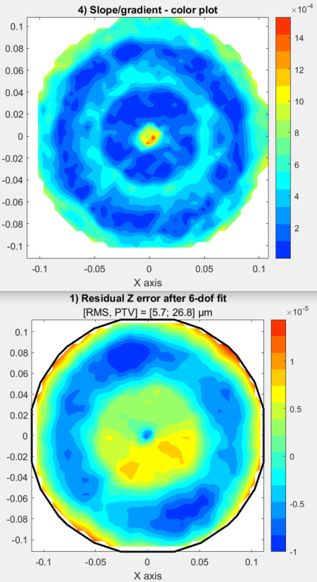
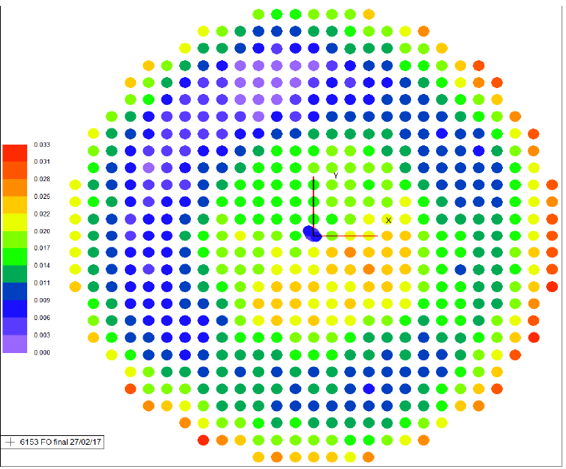
NAOMIX M2 – sn 6153
\\silvershare.fr.astrium.corp\PART\V\v2020\Com\D_Instrument NAOMIX\D-02_Ingenierie\D-02-b_Mécanique\2.1.Boostec\DRB_FM1-FM4\miroir M2\M2 6153\drb\A7 - coord XYZ ep peau-ep CVD M2 mirror SN 6153 - Rm.xlsx
581 points read
[X,Y] size = [0.224, 0.224]
RMS before fit: 79954.6 µm RMS
TZ-fit: -79954.6387 µm
RMS after TZ fit: 6.3 µm RMS
RMS after 6-dof fit : 5.7 µm RMS
PTV after 6-dof fit : 26.8 µm
6-dof fit: (µm & µrad)\n
TX | TY | TZ | RX | RY | RZ |
0.2 | -0.2 | -0.0 | 30.3 | 35.6 | 0.0 |
| | | 43 | 59 | |%
Volume under surface = 3.87e-01 mm²

Slide 17
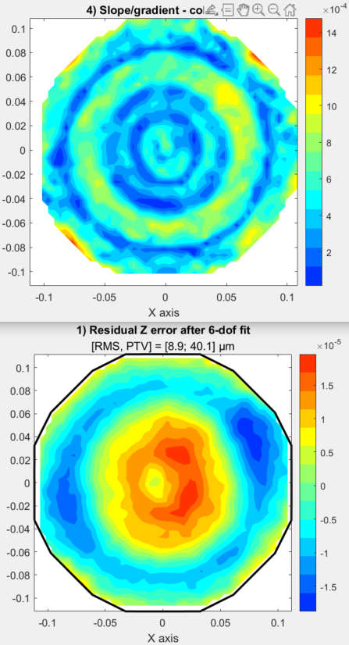
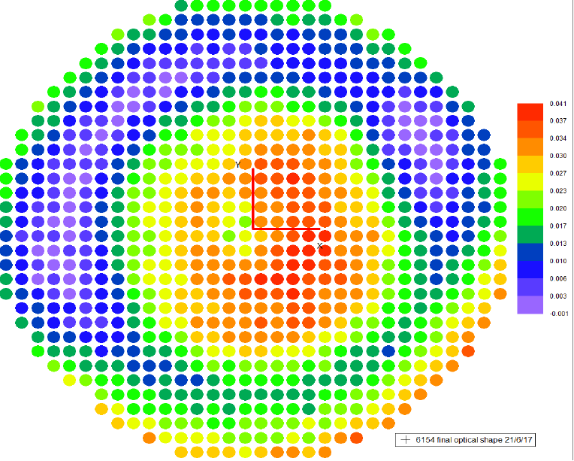
NAOMIX M2 – sn 6154
\\silvershare.fr.astrium.corp\PART\V\v2020\Com\D_Instrument NAOMIX\D-02_Ingenierie\D-02-b_Mécanique\2.1.Boostec\DRB_FM1-FM4\miroir M2\sn 6154 FM2\A7 - XYZ ep peau-ep CVD M2 NAOMIX SN 6154.xlsx
819 points read
[X,Y] size = [0.224, 0.224]
RMS before fit: 18.7 µm RMS
TZ-fit: -7.0963 µm
RMS after TZ fit: 17.4 µm RMS
RMS after 6-dof fit : 8.9 µm RMS
PTV after 6-dof fit : 40.1 µm
6-dof fit: (µm & µrad)\n
TX | TY | TZ | RX | RY | RZ |
1.2 | -1.1 | 0.0 | 165.7 | 194.0 | -0.0 |
| | | 50 | 65 | |%

Slide 18
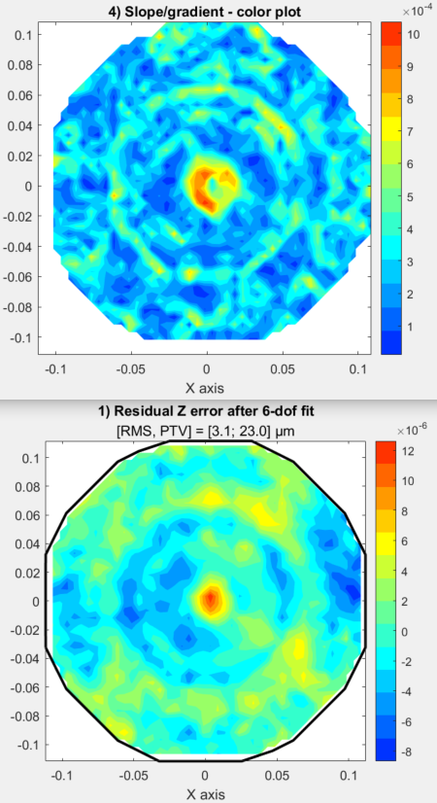
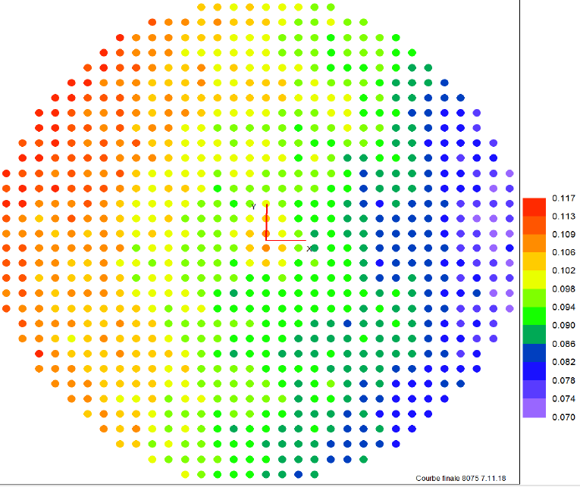
NAOMIX M2 – sn 6155 NOK
\\silvershare.fr.astrium.corp\PART\V\v2020\Com\D_Instrument NAOMIX\D-02_Ingenierie\D-02-b_Mécanique\2.1.Boostec\DRB_FM1-FM4\miroir M2\sn 6155\DRB\Naomix_M2_6155_8075_FO s CVD_20181107.xls
818 points read
[X,Y] size = [0.224, 0.224]
RMS before fit: 97.6 µm RMS
TZ-fit: -96.1613 µm
RMS after TZ fit: 16.7 µm RMS
RMS after 6-dof fit : 3.1 µm RMS
PTV after 6-dof fit : 23.0 µm
6-dof fit: (µm & µrad)\n
TX | TY | TZ | RX | RY | RZ |
-1.0 | 1.5 | 0.0 | -233.6 | -158.8 | 0.0 |
| | | 80 | 49 | |%
Volume under surface = 3.45e-01 mm²
PV Boostec NOK
Tol forme: 47µm

Slide 19
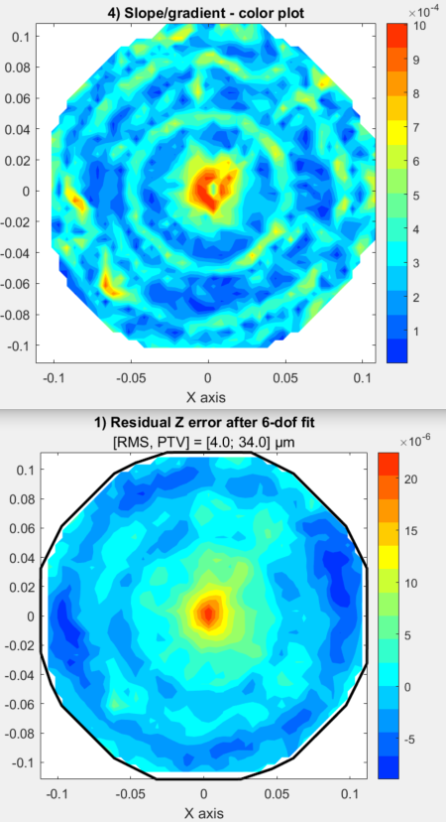
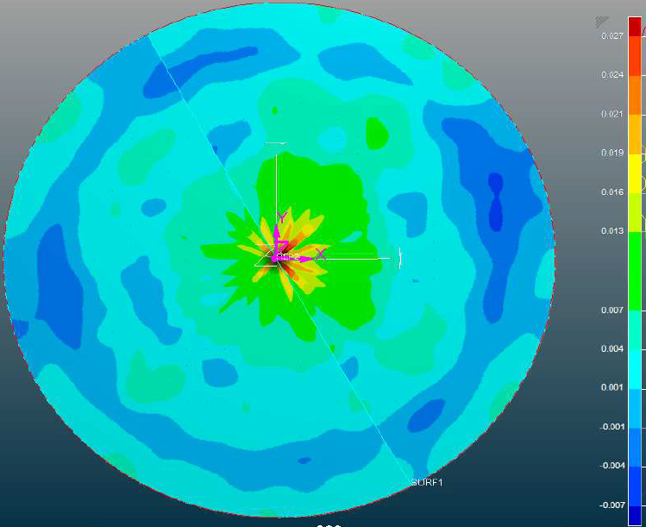
NAOMIX M2 – sn 7952
\\silvershare.fr.astrium.corp\PART\V\v2020\Com\D_Instrument NAOMIX\D-02_Ingenierie\D-02-b_Mécanique\2.1.Boostec\DRB_FM1-FM4\miroir M2\sn 7952\drb\Naomix_M2_7952_final_12042019.xls
817 points read
[X,Y] size = [0.224, 0.224]
RMS before fit: 135.0 µm RMS
TZ-fit: -134.7518 µm
RMS after TZ fit: 8.5 µm RMS
RMS after 6-dof fit : 4.0 µm RMS
PTV after 6-dof fit : 34.0 µm
6-dof fit: (µm & µrad)\n
TX | TY | TZ | RX | RY | RZ |
0.1 | 0.8 | 0.0 | -127.0 | 21.2 | 0.0 |
| | | 98 | 4 | |%
Volume under surface = 3.57e-01 mm²

Slide 20
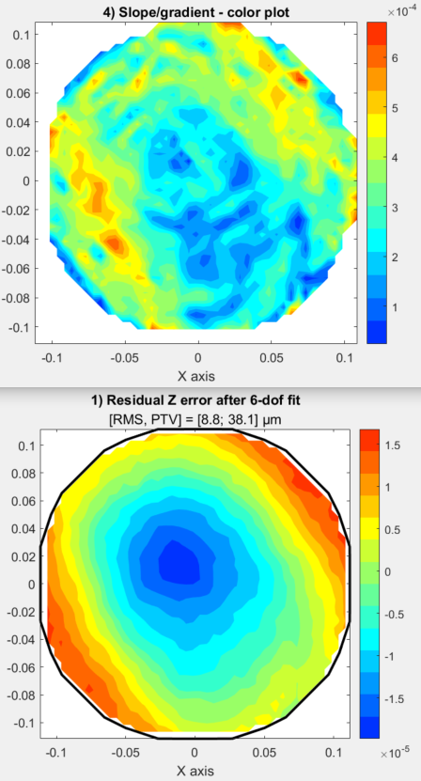
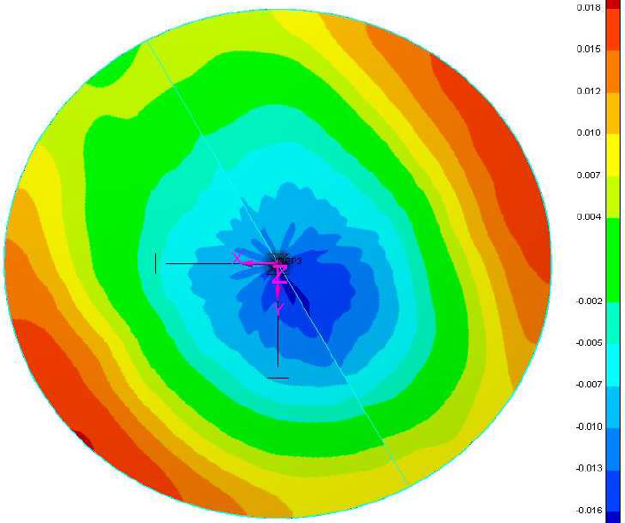
NAOMIX M2 – sn 8076
\\silvershare.fr.astrium.corp\PART\V\v2020\Com\D_Instrument NAOMIX\D-02_Ingenierie\D-02-b_Mécanique\2.1.Boostec\DRB_FM1-FM4\miroir M2\Sn 8076\Naomix_M2_8076_final_20201104.xls
723 points read
[X,Y] size = [0.224, 0.224]
RMS before fit: 111.7 µm RMS
TZ-fit: -111.0299 µm
RMS after TZ fit: 12.1 µm RMS
RMS after 6-dof fit : 8.8 µm RMS
PTV after 6-dof fit : 38.1 µm
6-dof fit: (µm & µrad)\n
TX | TY | TZ | RX | RY | RZ |
-0.1 | 0.9 | 0.0 | -140.3 | -16.9 | -0.0 |
| | | 99 | 2 | |%
Volume under surface = 7.70e-01 mm²

